Slide 1

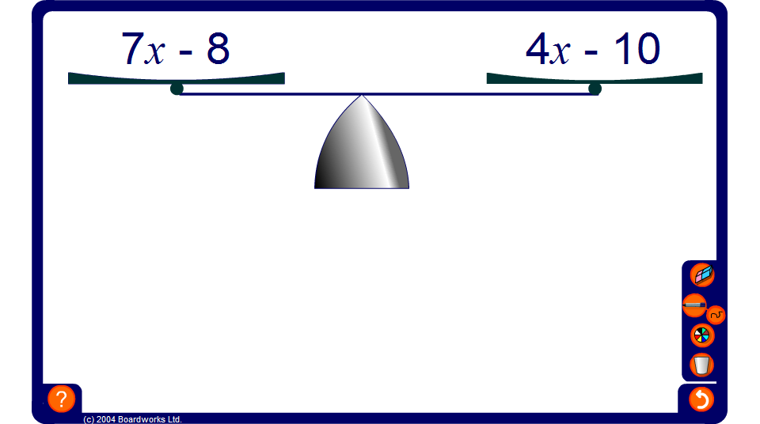


Balancing equations
Notes:
Remind pupils that we can think of equations as a pair of scales that balance. If we add, subtract, multiply or divide both sides of an equation by the same amount the equation will remain true.
Today we will look at equations with the unknown on both sides of the equals sign. We can’t solve these equations using inverse operations because different operations are performed on the unknown on either side of the bracket.
The way that we solve these equations is by doing the same thing to both sides, step by step, until we reach the solution in the form x = ‘a number’.
To reach this solution we must aim to collect unknowns on the left hand side and numbers on the right hand side.
Talk through as many examples as necessary on the board, asking pupils to suggest the operations to be performed. Ask pupils to justify the operations and the order in which they are done.
Note that if the coefficient of x (the number of x’s) on the right hand side of the equation is greater than the coefficient of x on the left hand side, we will have a negative coefficient of x when we collect the x’s on the left hand side. To ‘undo’ this we must divide by a negative number in the final step. As an alternative, we could collect x’s on the right hand side and swap the left hand side and the right hand side in the final stage or we could swap the left hand side and right hand side at the beginning.

